Slide 1

Custom Bootcamp
Week 4 (Sep 11-Sep 15)
Pagidala Saketh Reddy
Employee code: 655074
Unext ID: SH7B23136

Slide 2

Agenda
Sep 11th– Doubt Solving Session
Sep 12th – Azure Synapse Analytics
Sep 13th– Power BI
Sep 14th – Power BI
Sep 15th – Power BI Hands on and Python

Slide 3

Azure Synapse Analytics
Serverless SQL pool in Azure Synapse Analytics
Every workspace comes with a serverless SQL that you can use to query data in the Azure Data Lake
Dedicated SQL pool
Dedicated SQL pool represents a collection of analytical resources that are provisioned when using synapse SQL.
While Serverless doesn’t store data, only access data from storage accounts and scale the MPP environment automatically, the dedicate SQL pool keeps a static number of servers according to the service level we choose and a constant number of distributions always 60.

Slide 4
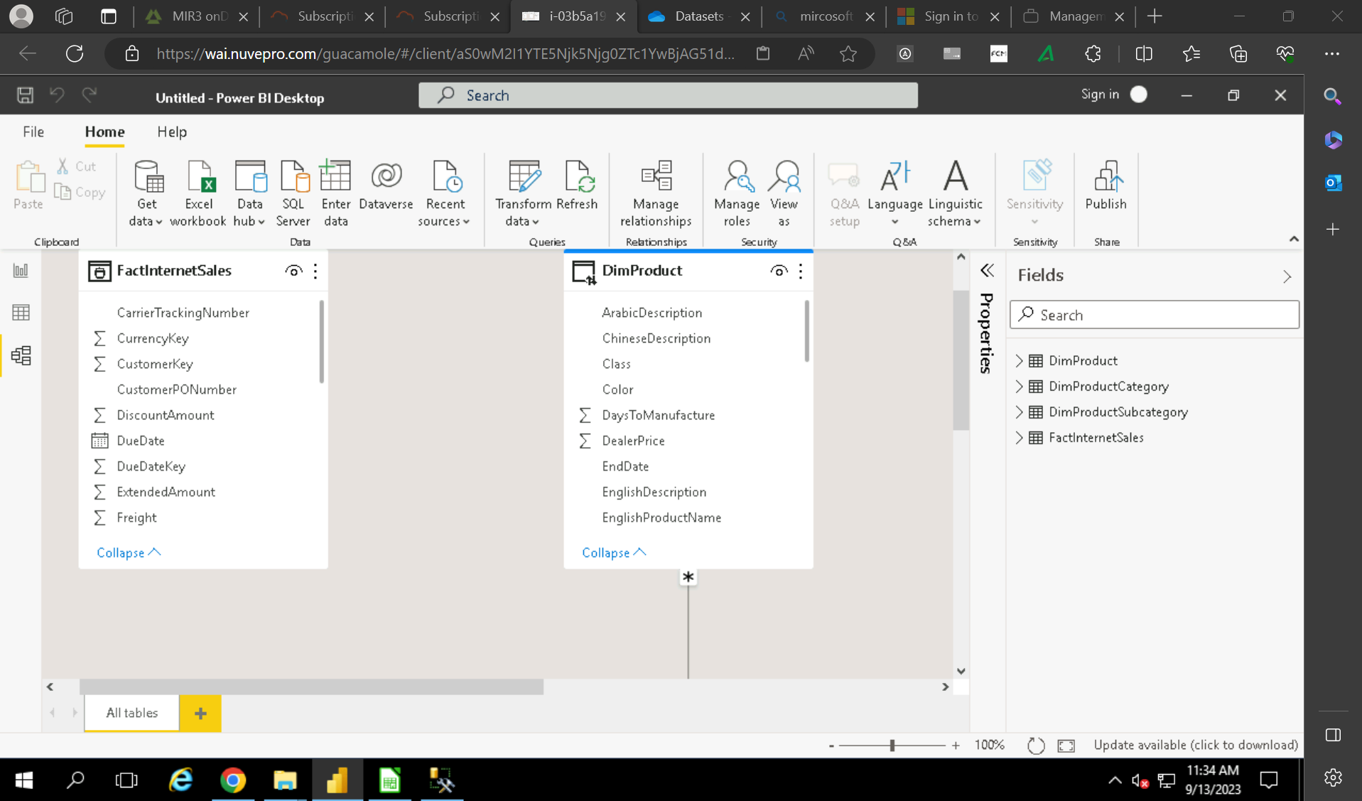
Power BI
Power BI
Microsoft Power BI is an interactive data visualization software product developed by Microsoft with a primary focus on business intelligence.
Power Query
It is a Data Transformation and Data Preparation tool included with Microsoft excel and Microsoft power bi.

Slide 5
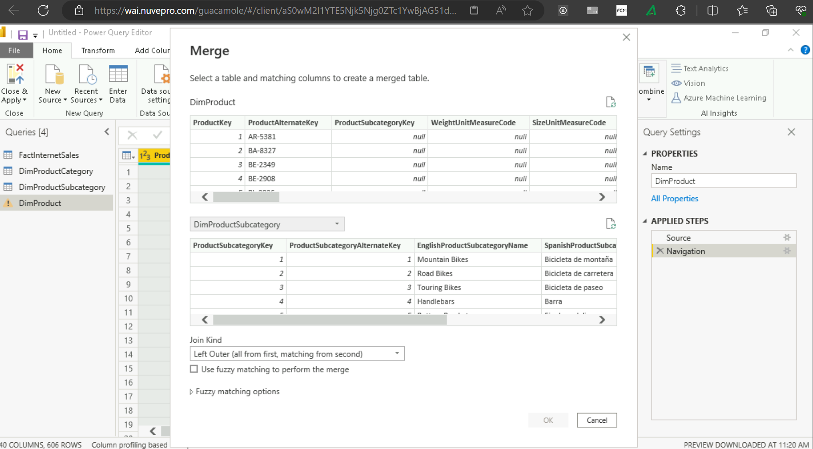
Azure Power BI
Join or Merging two tables

Slide 6
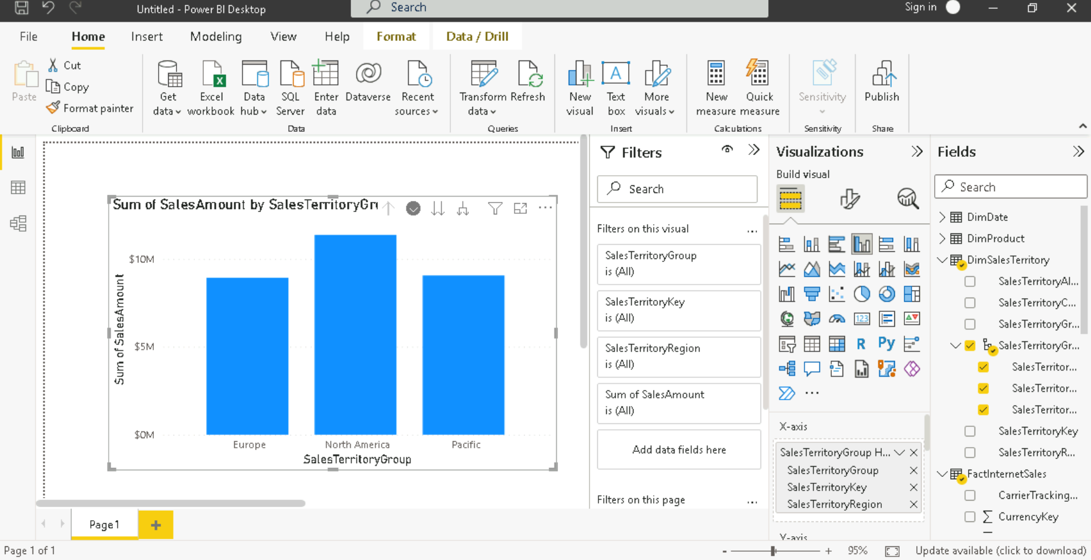
Azure Power BI
Creating Hierarchy
Building different charts based on a scenario

Slide 7
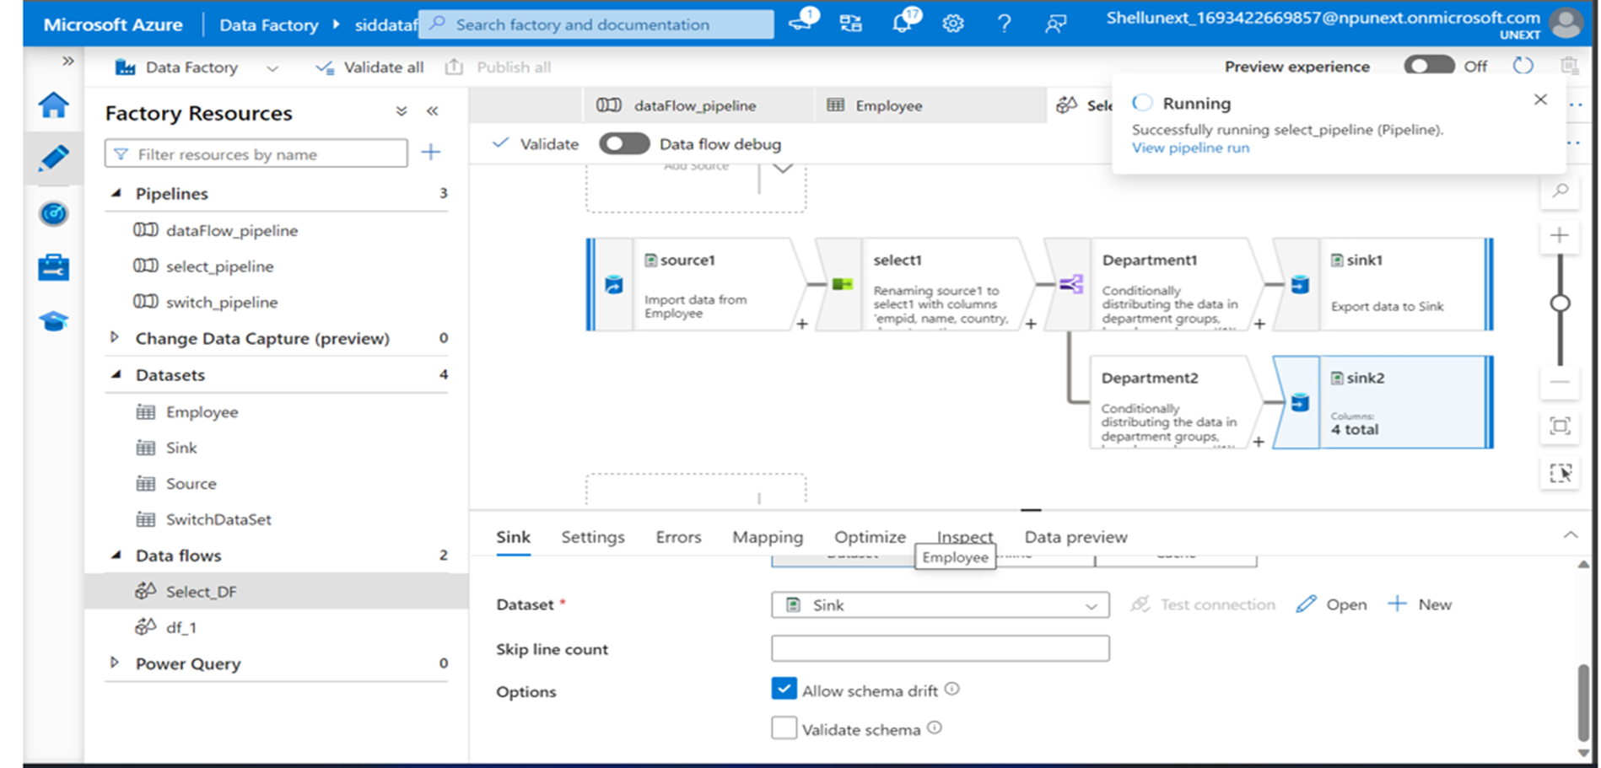
Azure Hands On

Slide 8
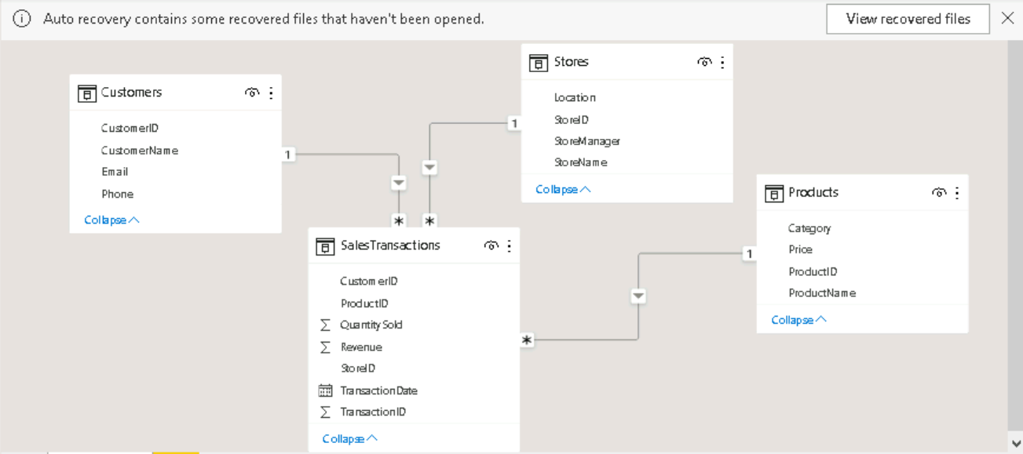
Power BI Hands On Assessment
Scenario: Sales Performance Analysis with Power BI
In this scenario, let's imagine you work for a retail company and you've been tasked with analyzing the sales performance of your products and stores using Power BI. You have multiple data sources and tables to work with, and your goal is to provide actionable insights to improve sales strategies.

Slide 9
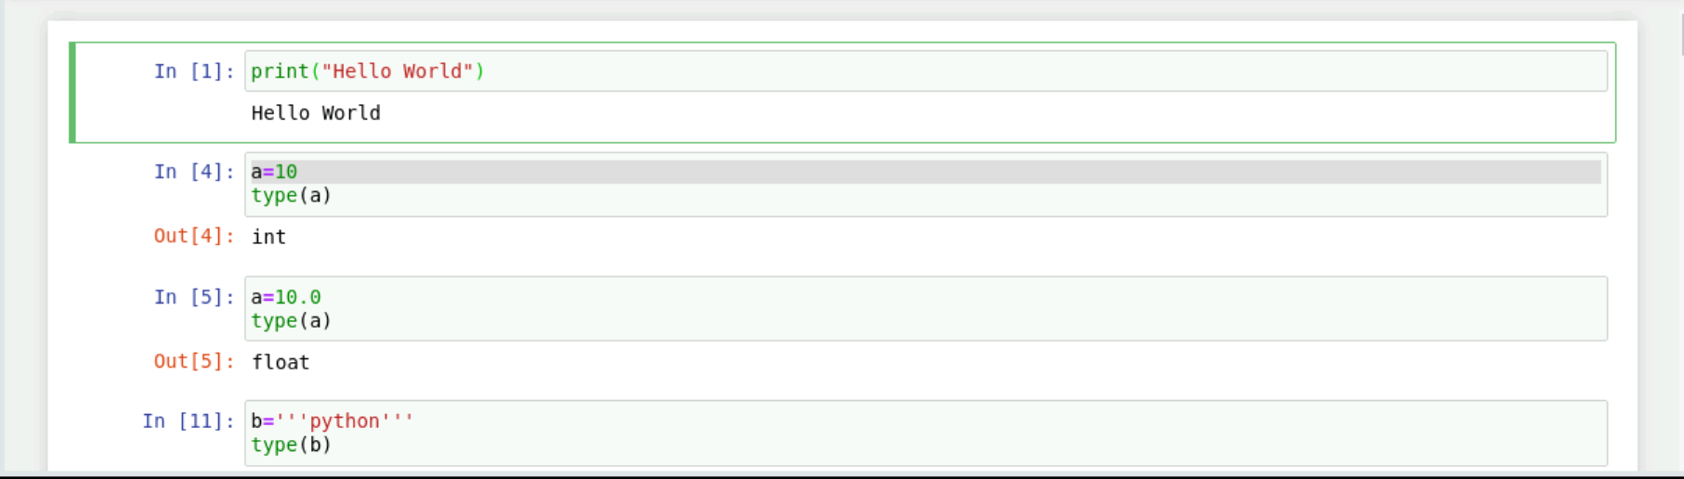
Python
Data Types
Arithmetic operators
Lists
Tuples

Slide 10
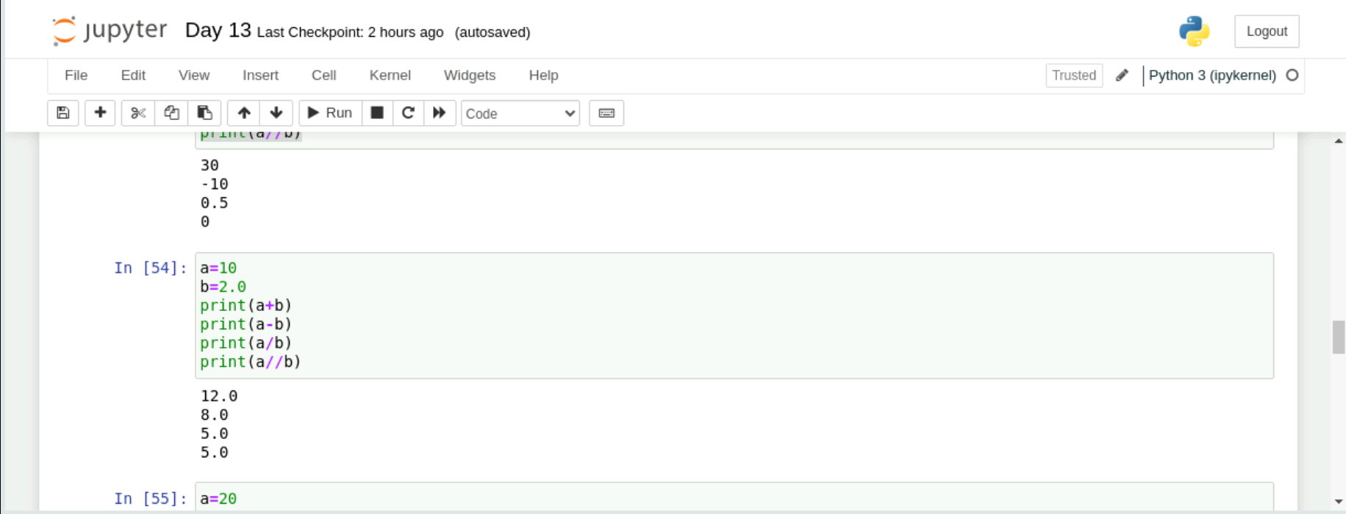
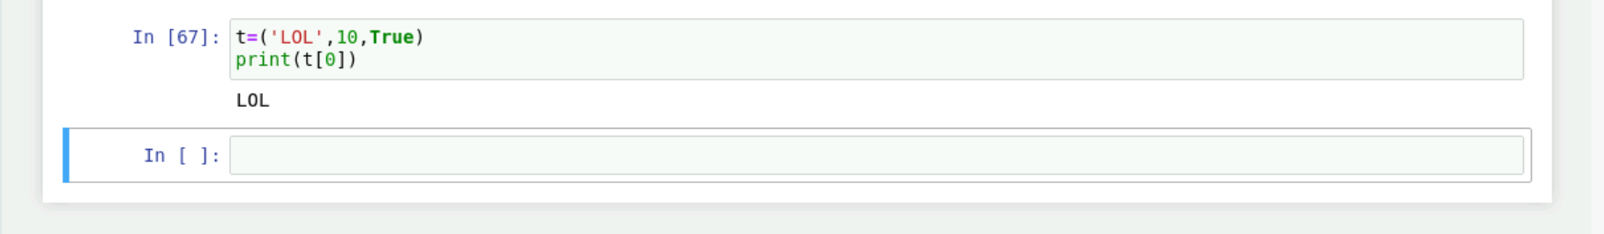
Python

Slide 11

Thank You

